Slide 1
Achieving Permanence
Workshop Three
Making the permanence decision
Notes:
1
Presentation: welcome to workshop

Slide 2
Achieving permanence
Workshop three
Making the permanence decision
09.30 – 11.00 Review learning
Critical thinking
11.00 – 11.10 Break
11.10 – 12.45 Systemic assessment models
12.45 – 13.45 Break
13.45 – 15.00 Person-centred plans
15.00 – 15.10 Break
15.10 – 16.30 Explaining decisions
Notes:
2
Presentation

Slide 3
Learning outcomes
Participants will be offered opportunities to:
evaluate relevant up-to-date research with a view to sustaining evidence-based assessment, planning and decision-making
differentiate between intuitive, reflective, analytical and critical thought processes with a view to applying these purposefully in social work assessment, planning and decision-making
exemplify the role of practice wisdom in advanced social work
prepare written and oral evidence that properly reflects the role of advanced social workers as expert witnesses and key advocates in communicating the needs of the child/young adult
demonstrate capacity to meet the time frames for the developing child/young adult and challenge court and local authority processes if timely decisions are not made.
Notes:
presentation

Slide 4
Agreeing how we aim to work together today
respecting and valuing others
valuing difference
confidentiality
building on similarities
careful listening/room to speak
respecting right to challenge constructively
time boundaries
mobile phones
treating yourself and others kindly.

Slide 5
Lemn Sissay: A child of the state
I slowly became aware that I knew nobody that knew me for longer than a year. See, that’s what family does. It gives you reference points. I’m not defining a good family from a bad family. I’m just saying that you know when your birthday is by virtue of the fact that somebody tells you when your birthday is; a mother, a father, a sister, a brother, an aunt, an uncle, a cousin, a grandparent. It matters to someone, and therefore it matters to you. Understand, I was 14 years old, tucked away in myself, and I wasn’t touched either, physically touched.
Notes:
Supports large group discussion

Slide 6

Notes:
Use as backdrop to discussion in pairs or threes

Slide 7
Permanence
The variety of possible routes to permanence should be equally valued, and share common principles in planning to meet children and young adults’ lifetime needs:
remaining at home with concerns addressed, safe and secure
a permanent return to birth parents after time in care
shared care arrangements, including regular short-break care
permanence within the looked after system, whether in residential placement, unrelated foster care or family and friends care
pathways to legal permanence, through adoption, special guardianship orders and child arrangements order.
Notes:
Supports large group discussion

Slide 8

WHAT IS THE BIGGEST DIFFICULTY YOU FACE WHEN YOU ARE RESPONSIBLE FOR MAKING DECISIONS?
Notes:
Supports discussion in pairs or threes

Slide 9

What would the children/young adults you work with say is the best thing about you as their social worker?
This Photo by Unknown Author is licensed under CC BY
Notes:
Supports individual task

Slide 10

What do you need to do
so that you can build on
your existing skills, expertise & confidence?
This Photo by Unknown Author is licensed under CC BY
Notes:
Supports individual task

Slide 11
Part One
Critical thinking
Notes:
Presentation: Outline content and process of session one

Slide 12

This Photo by Unknown Author is licensed under CC BY-NC-ND
Notes:
Use as backdrop to small group task

Slide 13

CRITICAL THINKING AND ANALYTICAL SKILL AUGMENT AND HARNESS INTUITION
‘Consider a range of realistic permanence options and the strengths and risk factors of each… weigh up the pros and cons of the options available.’
K&SS:AP (2016) 1) Decide on the best permanence option
This Photo by Unknown Author is licensed under CC BY-SA
Notes:
Supports large group discussion

Slide 14

Thinking and feeling
This Photo by Unknown Author is licensed under CC BY-ND
Notes:
Supports large group discussion

Slide 15
The role and toll of emotion
The primitive feelings generated by complex, unpredictable situations can have the effect of disrupting cognition and fragmenting thought processes. Such experiences make it difficult for an individual of group to think coherently about a situation.
Ruch, 2007
Notes:
Supports large group discussion

Slide 16

Reflection
Is about looking after yourself…
…..as well as….
challenging yourself
Brown, Moore and Turney, 2011
Grant and Kinman, 2011
This Photo by Unknown Author is licensed under CC BY
Notes:
16
Supports large group discussion

Slide 17
How?
by asking questions like…
how do you feel about this situation?
what do you think this means?
could you have done this differently?
what does this remind you of?
and more…
Notes:
17
Supports large group discussion

Slide 18
Emotion and defensible practice
emotion is critical to judgement
“Leaders in high performing companies have twice as much Emotional Intelligence in those as low performing companies.”
Goleman, 1998
“A system that seeks to ignore emotions is in danger of leaving them to have an unknown and possibly harmful impact on the work, and is also neglecting a rich source of data to help us understand what is going on.”
Munro, 2008
Notes:
Supports large group discussion

Slide 19
With an issue as important as children’s welfare, it is vital to have the best standard of thinking that is humanly possible. Mistakes are costly to the child and family
Munro, 2008
‘Take account… Identify and harness… Take into account… Acknowledge… Assess… Address complex questions… Be prepared to give feedback on processes and procedures…’
K&SS:AP (2016) 1) Decide on the best permanence option
Recognise the effects of unconscious bias and risk aversion on supervision and utilise supervision to reflect in dilemmas..’
K&SS:AP (2016) 3) Help children find permanence

Slide 20
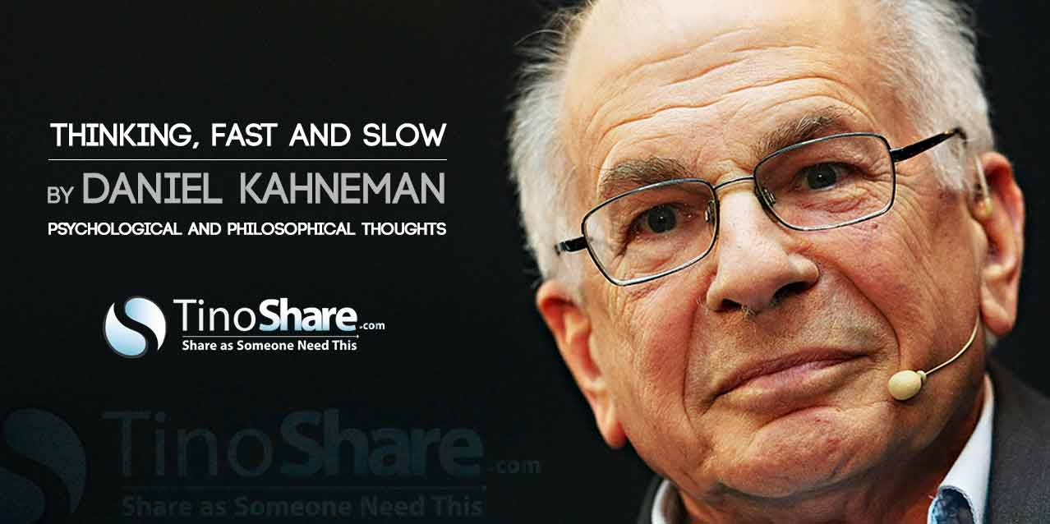
This Photo by Unknown Author is licensed under CC BY-NC
Notes:
Presentation

Slide 21
Thinking fast and slow,
Daniel Kahneman, 2011
I went out and bought a bat and ball. Together they cost me £1.50.
The bat cost £1.00 more than the ball.
HOW MUCH DID I SPEND ON THE BALL?
Notes:
Supports large group activity

Slide 22
Really?! Are you sure?
Notes:
Supports large group activity

Slide 23
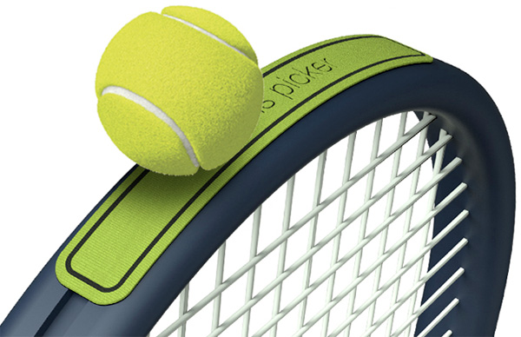
Answer
The ball cost me 25 pence!
25p + £1.25 = £1.50
50p + £1.50 = £2.00
This Photo by Unknown Author is licensed under CC BY-NC-SA
Notes:
Supports large group activity

Slide 24
Thinking fast and slow
‘Stressed’ state
(system 1)
Cortex engagement
(system 2)
use of “primitive brain” -12 milliseconds to receive information
no in-depth information - data is sent – ‘quick and dirty’
alarm system for the body – primes body for action and subsequent actions are hard to control.
engages cortex-25 milliseconds to reach a connection (double the primitive system)
slower, less instinctual and overridden by the primitive brain if danger is sensed
analytical thinking.
Notes:
Presentation

Slide 25

Notes:
Presentation

Slide 26
Critical thinking: a process
intuition
experience
practice wisdom
reflection-in-action
reflection-on-action
critical reflection
analysis
hypothesising
critical thinking
Notes:
Presentation

Slide 27
Critical and analytical writing
content
sense of audience
clarity
analysis
Cottrell, 2005
selection
sequence
best order
group similar points
signpost
Notes:
Supports large group discussion

Slide 28
Signing the way
introduce the line of reasoning
add similar reasons
add different reasons
strengthen the argument
introduce alternative arguments
rebut alternative arguments
contrast and contradictions
express results and consequences
draw conclusions.
Cottrell, 2005
Notes:
Supports large group discussion

Slide 29
THE ANCHOR PRINCIPLES
  Set out a five-question framework for critical thinking ensuring that assessment is firmly anchored to analysis at all stages:
What is the assessment for
What’s the story?
What does the story mean?
What needs to happen?
How will we know we’re making progress?
  Brown, Moore and Turney, 2011
Notes:
presentation

Slide 30

INTUITION CRITICAL THINKING
PROFESSIONAL JUDGEMENT
This Photo by Unknown Author is licensed under CC BY-SA
Notes:
Supports plenary

Slide 31
In a nutshell…
critical thinking
Experience and wisdom
Reflection
Analysis
Information
(can include intuition)
Notes:
Only use this summary if needed

Slide 32
Part Two
Systemic assessment models
Notes:
Presentation: Outline content and process of session two

Slide 33
Assessment framework triangle
Health
Basic Care
Education
Ensuring Safety
Emotional & Behavioural
Development
Emotional Warmth
Identity
PARENTING CAPACITY
CHILD’S DEVELOPMENTAL NEEDS
CHILD
Safeguarding and promoting welfare
Stimulation
Family & Social
Relationships
Guidance &
Boundaries
Social Presentation
Self Care Skills
Stability
FAMILY AND ENVIRONMENTAL FACTORS
Family History and Functioning
Wider Family Housing Employment
Income Family’s Social Integration
Community Resources
National Assessment Framework, 2001
Notes:
33
Supports small group discussion and plenary

Slide 34
Lessons from research and serious case reviews:
Critical issues in assessment
analysis: descriptive/static not interactive
focus on events not patterns
over-focus on behaviour not explanation
early impressions dominate
tendency to start again and lose history
higher on intuition – lower on analysis
resistance to revising analysis
parent’s explanations over-ride children/young adult’s views.
©T.Morrison/J.Wonnacott 2009
Notes:
Presentation

Slide 35
Working with fragmented health systems
Understanding medical conditions as part of SW assessments
Professional challenge /complex systems/skills in being assertive
Placement with families and implications for assessment
Confidence in working with CSA
The meaning of children / young adult’s behaviour – avoiding misplaced blame
Using basic CP procedures
OVERARCHING FINDINGS FROM SERIOUS CASE REVIEWS
Wonnacott, 2015
Notes:
Presentation

Slide 36
MACROSYSTEM
MESOSYSTEM
EXOSYSTEM
MICROSYSTEM
Bronfenbrenner, 1979
Notes:
Presentation

Slide 37
WIDER CULTURAL &
SOCIO-ECONOMIC SYSTEM
SPOUSAL SYSTEM
CAREGIVER AS PARENT
CHILD ATTACHMENT SYSTEM
FAMILY AND WIDER SUPPORT
Farnfield, 2008
Notes:
Supports large group discussion

Slide 38
CULTURE AND COMMUNITY
RISKS, STRESSORS AND VULNERABILITY FACTORS
CAREGIVER’S NEEDS, WELL-BEING & DIFFICULTIES
THE RELATIONSHIP
BETWEEN
CAREGIVER AND CHILD
CHILD’ / YOUNG ADULT’S
NEEDS,
WELL-BEING, & DIFFICULTIES
SUPPORT FOR CAREGIVER
SUPPORT FOR CHILD
PROTECTIVE FACTORS AND RESOURCES
CULTURE AND COMMUNITY
Mainstone, 2014 adapted from Crossing Bridges 1998 & Falkov, 2012
Notes:
38
Presentation

Slide 39
CAREGIVER’S NEEDS, WELL-BEING & DIFFICULTIES
CHILD / YOUNG ADULT’S
NEEDS,
WELL-BEING &
DIFFICULTIES
THE RELATIONSHIP
BETWEEN
CAREGIVER AND CHILD
Notes:
39
Supports small group activity

Slide 40
RISKS, STRESSORS AND VULNERABILITY FACTORS
CAREGIVER’S NEEDS, WELL-BEING & DIFFICULTIES
CHILD / YOUNG ADULT’S
NEEDS,
WELL-BEING &
DIFFICULTIES
THE RELATIONSHIP
BETWEEN
CAREGIVER AND CHILD
PROTECTIVE FACTORS AND RESOURCES
Notes:
40
Supports small group activity

Slide 41
SAFETY IS STRENGTHS DEMONSTRATED AS PROTECTION OVER TIME
Turnell, 1998
Motivation for change
Capacity for change
Impact of unresolved trauma / loss
Impact of unmet need
Notes:
Supports large group discussion.

Slide 42
Assessing harm and promoting safety…
What behaviour/changes to behaviour are required to meet this child / young adult’s needs?
How will you know when this behaviour has been achieved and sustained?
Who has the motivation to meet the child/young adult’s needs?
Who has the capacity to meet the child/young adult’s needs?
intellectual capacity
emotional/psychological capacity?
physical/practical capacity?
What could get in the way of change being achieved (unmet needs/impact of trauma/personality traits)?
What could get in the way of change being sustained (unmet needs/impact of trauma/personality traits)?
Mainstone, 2014
‘Assess the impact of trauma, abuse, neglect, separation and loss of a child’s development, and how this affects their capacity to build and maintain relationships. Take account of the child’s developmental stage and the likely impact of different transitions, as well as the support the child may need along the way. Identify and harness the wider services the child may need to recover from previous experiences and to achieve stability.
K&SS:AP (2016) 1) Decide on the best permanence option
Notes:
Supports small group activity

Slide 43
RISKS, STRESSORS AND VULNERABILITY FACTORS
CHILD’S
NEEDS,
WELL-BEING
&
DIFFICULTIES
CAREGIVER’S NEEDS, WELL-BEING & DIFFICULTIES
THE RELATIONSHIP
BETWEEN
CAREGIVER AND CHILD
SUPPORT FOR CAREGIVER
SUPPORT FOR CHILD
PROTECTIVE FACTORS AND RESOURCES
Notes:
43
Supports small group activity

Slide 44
CULTURE AND COMMUNITY
RISKS, STRESSORS AND VULNERABILITY FACTORS
CAREGIVER’S NEEDS, WELL-BEING & DIFFICULTIES
CHILD’S
NEEDS,
WELL-BEING
&
DIFFICULTIES
THE RELATIONSHIP
BETWEEN
CAREGIVER AND CHILD
SUPPORT FOR CAREGIVER
SUPPORT FOR CHILD
PROTECTIVE FACTORS AND RESOURCES
Mainstone, 2014 adapted from Crossing Bridges 1998 & Falkov, 2012
CULTURE AND COMMUNITY
Notes:
44
Supports small group activity

Slide 45
THE ANCHOR PRINCIPLES
  Set out a five-question framework for critical thinking ensuring that assessment is firmly anchored to analysis at all stages:
What is the assessment for
What’s the story?
What does the story mean?
What needs to happen?
How will we know we’re making progress?
  Brown, Moore and Turney, 2011
Notes:
Supports small group activity

Slide 46
Part Three
Person-centred plans
Notes:
Presentation: Outline content and process of session three

Slide 47
The permanence framework
legal
physical
psychological
Notes:
Presentation

Slide 48
?
Why do we create plans that are not child-centred?
What gets in the way of engaging children in planning processes?
‘Give due considerations to the child’s preferences and ensure that where these cannot be acted upon, there is a clear rationale for that. Keep the child and their families informed and communicate clearly, openly and sensitively any decisions regarding their future.’
K&SS:AP (2016) 3) Help children find permanence
Notes:
Supports small group discussion and plenary

Slide 49
Barriers to maintaining a focus on the child
Organisational | Interpersonal | System
lack of time short cuts and ‘work arounds’ lack of knowledge and skills needed for observation and direct work with children and their family habituation to low standards of parenting lack of communication between and within agencies. Adapted from Turney et al, 2012, p.111 In collaboration with Family Rights Group | understanding children’s loyalty to their parents concerns about managing confidentiality failure to listen to people who know the child well over-identification with parents parents making it difficult for children to be seen parents diverting attention from concerns misusing strengths-based approaches domestic abuse dynamics e.g. focusing on victim’s failure to protect rather than perpetrator’s behaviour fears of violence emotional impact of the work. | pressure to deliver cost effectiveness professionals feeling overwhelmed lack of tailored resources e.g. camhs, respite etc.
Notes:
Only use this slide if necessary to deal with any significant gaps in the discussion so far

Slide 50
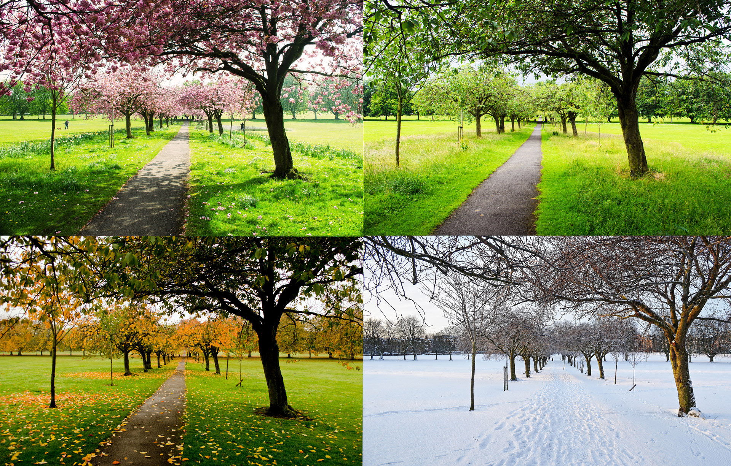
Notes:
Supports discussion in large group

Slide 51
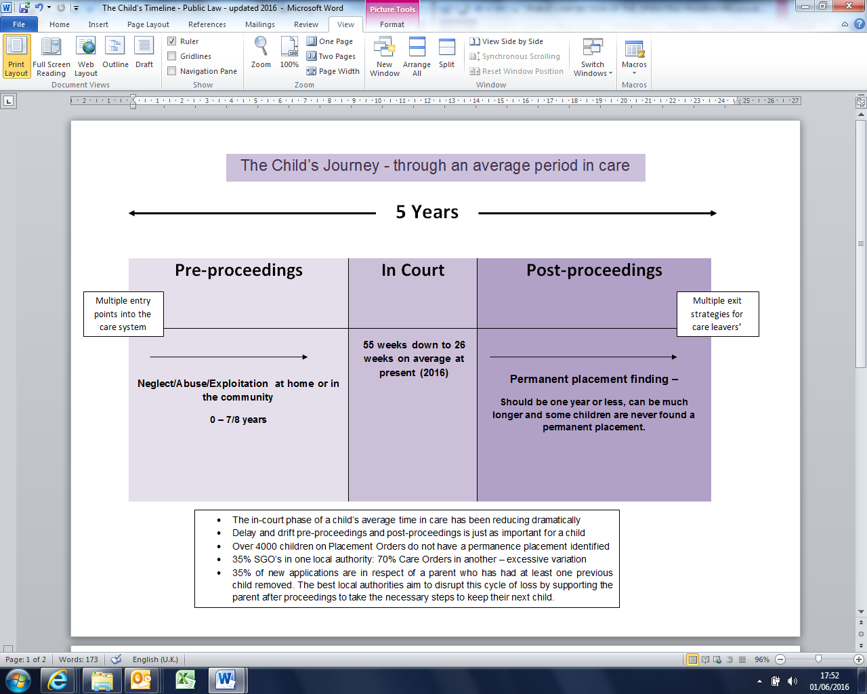
Cafcass 2017
Notes:
Use this slide to summarise if groups have not captured the full picture

Slide 52
What influences permanence decisions?
SYSTEM PRESSURES
BALANCING PERCEPTIONS AND FEELINGS
RELATIONSHIPS
DECISION
Rouf et al 2012
Notes:
Supports large group discussion

Slide 53
What makes a good plan?
child’s participation
participation of all those with parental responsibility and other interested family/friends
focused
proactive
brings together other plans
has a contingency plan
‘SMART’/ExACT design principles.
Notes:
53
Only use this slide if necessary to fill in gaps in the discussion so far

Slide 54

Olivia’s un-named son
Notes:
Distribute the case study: Olivia’s un-named son

Slide 55
Components of the permanence plan
Where to place? (stay with current carers/ move to kin/ move to new family)
What legal status? (adoption, special guardianship, ‘part of the family’ foster care)
What sort of contact, with whom, where, how often, facilitated? supervision needed?
What financial support, and to whom?
What social work and other support?
What therapeutic input, when and for whom?
To be considered in their own right in each case – not as ‘packages’/’custom and practice’
Notes:
Supports small group activity

Slide 56
Theoretical frameworks
or
child-focused plans
ATTACHMENT
RESILIENCE
DEVELOPMENT
Notes:
56
Supports small group activity

Slide 57
Framework for decision trees
what decision is to be made?
what options are there?
what information is needed to help make the choice?
what are the likely/possible consequences of each option?
how probable is each consequence? (likelihood)
what are the pros and cons of each consequence? (desirability)
The final decisions.
Notes:
Presentation

Slide 58
Part Four
Explaining decisions
Notes:
Presentation: Outline content and process of session four

Slide 59
The permanence plan must make sense!
The child
Birth family and friends
Professional network
The judiciary
The care-giver
Notes:
Presentation

Slide 60
Risk Aversion
Over optimism
Risk Sensible
Notes:
Supports large group discussion

Slide 61
“Defensible” decision-making
move away from defensive risk management – not risk averse
can be judged as sound decisions
made after consideration of all the information
evidently reasoned and justifiable
even if the outcome was not what was expected
Notes:
Presentation

Slide 62
The evidence base
“Evidence is fundamental in social work practice. Social workers use direct observation and evidence from the child, family or others who know them to form an understanding of what is going on. They can use evidence from research to inform their analysis of why any problems are happening and they can use evidence of effectiveness to guide their plans on how to help solve the problems”
Munro, 2011
‘Use research to draw evidence-based conclusions about the best permanence option for a child.’
K&SS:AP (2016) 1) Decide on the best permanence option
Notes:
Supports large group discussion

Slide 63
CITING RESEARCH
Permanence decisions are often made in complex circumstances where a practitioner will need to substantiate their thinking, conclusions and recommendations by citing research that has informed them. It is especially helpful to cite research that has influenced the weighing up of competing explanations or approaches
‘Draw on research that is relevant to an individual child’s specific circumstances and use it to inform how their short and long term needs, including their sense of identity and belonging, can best be met.’
K&SS:AP (2016) 1) Decide on the best permanence option
Notes:
Supports large group discussion

Slide 64
Evidence-based permanence planning
RESEARCH EVIDENCE
PRACTICE KNOWLEDGE AND EXPERIENCE
PEOPLE’S
EXPERIENCE AND PERSPECTIVE
Notes:
Summarise the introduction to this session

Slide 65

OLIVIA
AN I.R.O.
LANA
G.A.L.
ETHAN
FINANCE OFFICER
BEN
JUDGE
STAND IN THEIR SHOES!
‘Communicate effectively and confidently in court and offer a clear rationale for recommendations. Present to the court a balanced picture of the child’s needs and evidence of previous support and interventions that are relevant to the permanence decision-making process.’ K&SS:AP (2016) 2) Negotiate the legal process
Is this plan DEFENSIBLE?
GET CRITICAL!
EXPLAIN!
Notes:
Supports small group activity

Slide 66
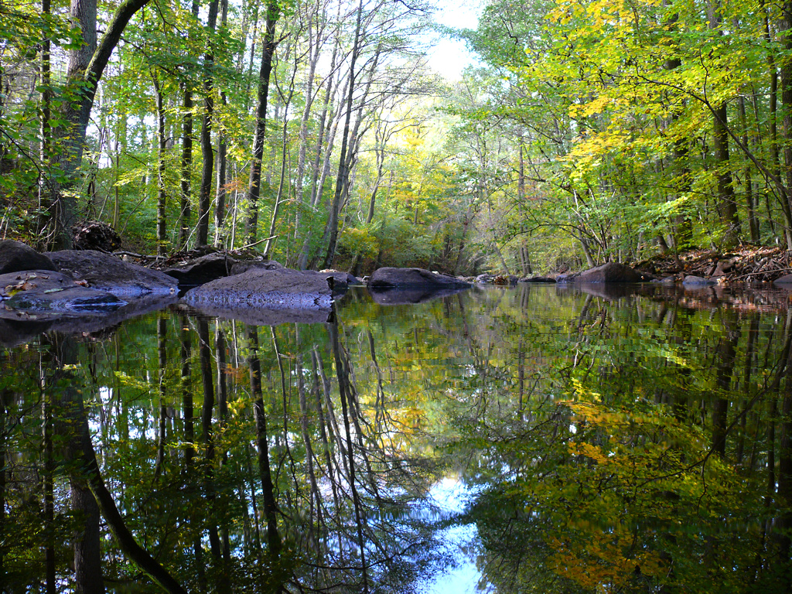
Notes:
Supports plenary

